Slide 1


Variability of the North American Monsoon
Madelyn Powell
Mentor: Dr. Mark Sinclair
Embry Riddle Aeronautical University
26TH aNNUAL aRIZONA/nasa sPACE gRANT uNDERGRADUATE rESEARCH sYMPOSIUM
April 21-22, 2017
Sheraton phoenix airport hotel
Tempe, AZ

Slide 2
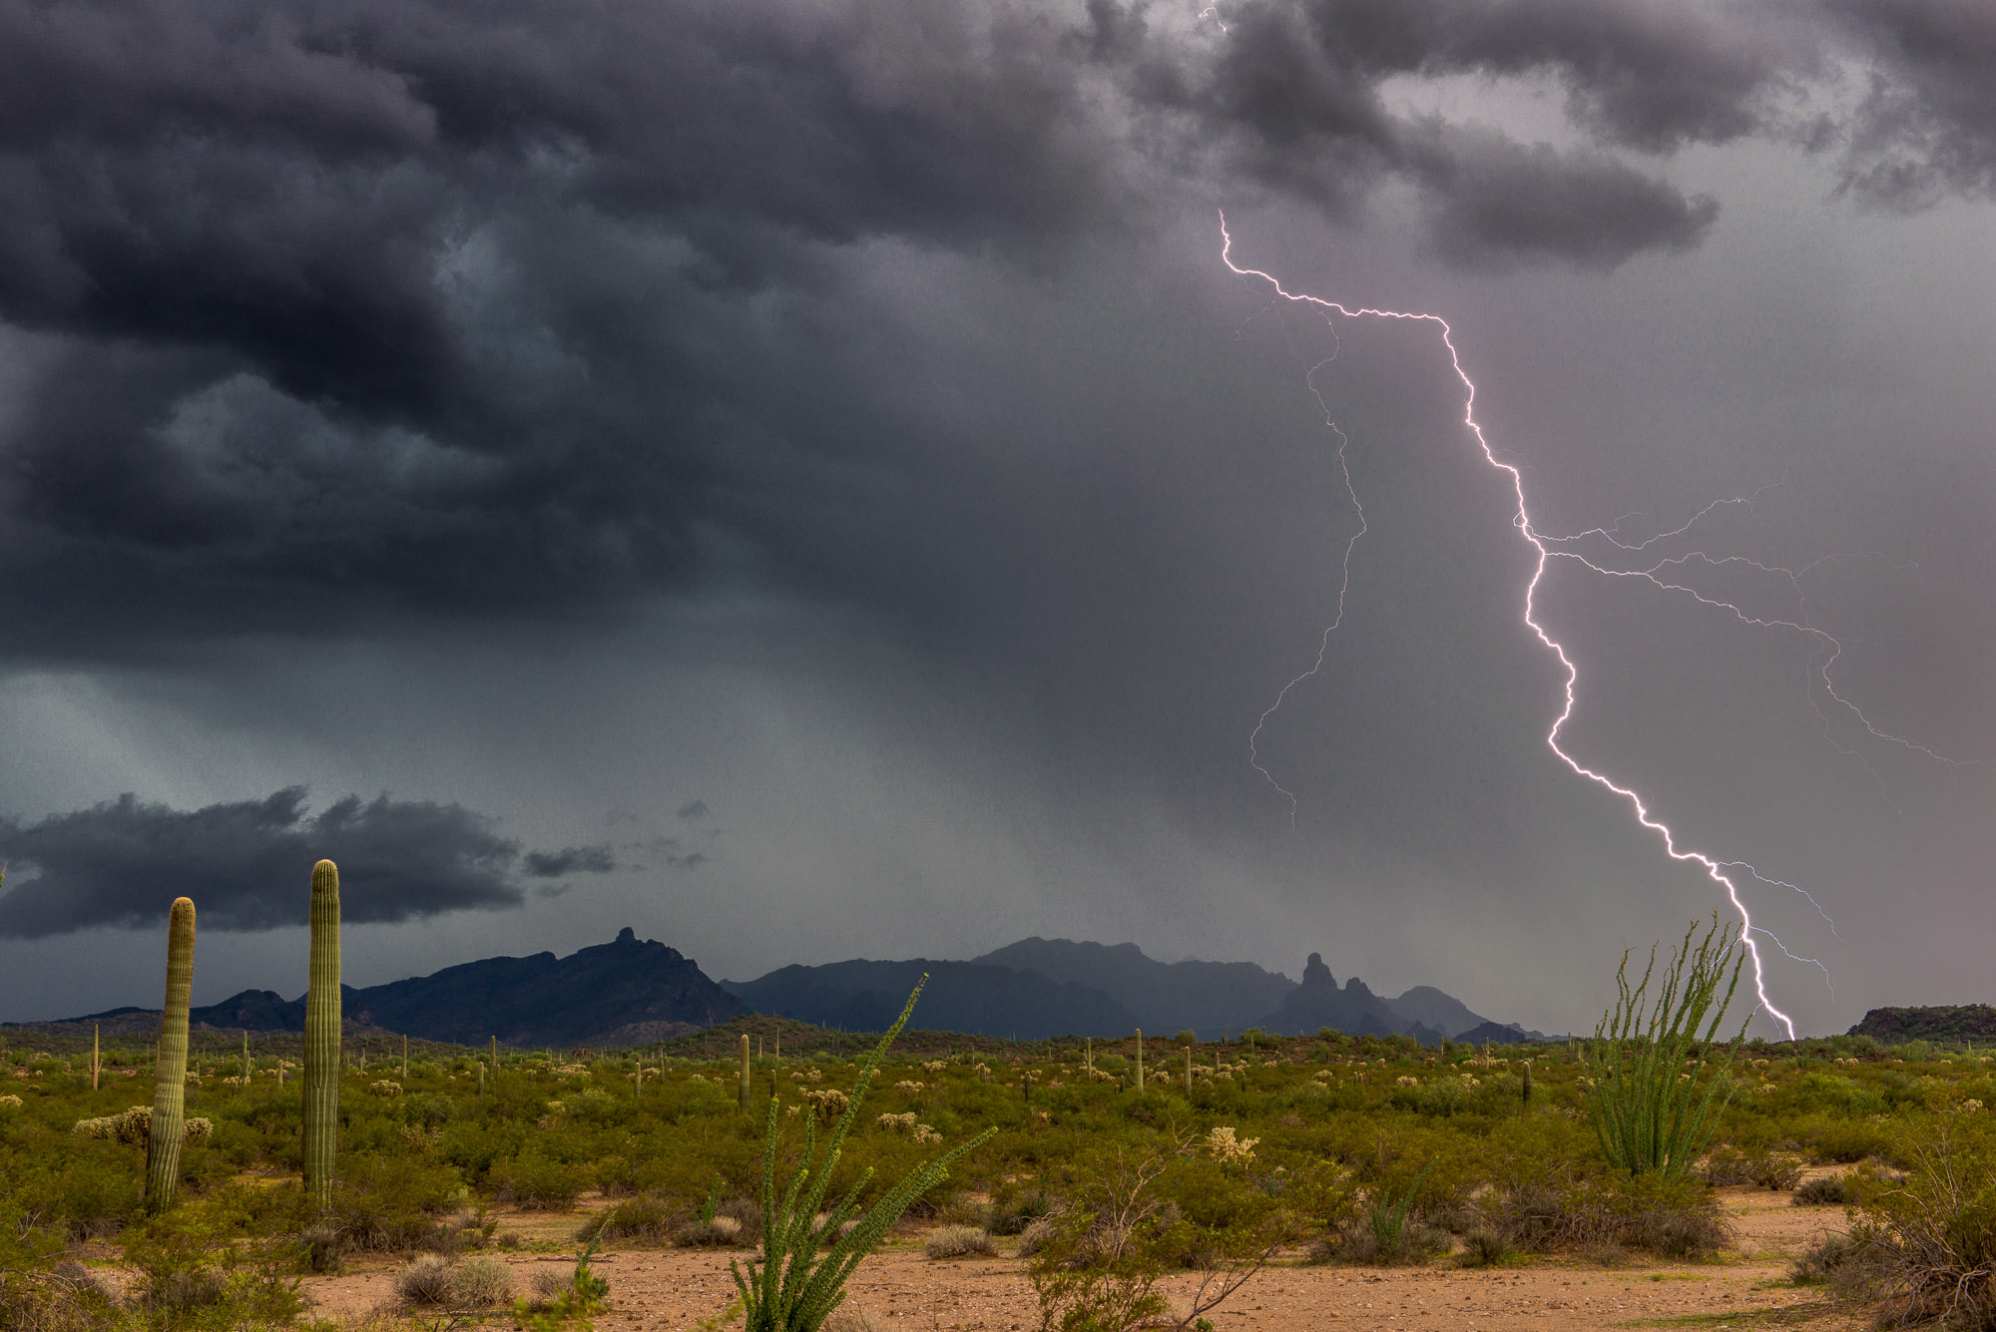
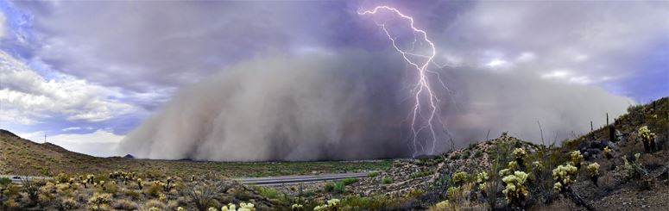
Motivation
Some years are wetter than average and others are dryer.
This study was done in order to better understand precipitation variability during the monsoon.
  Understanding precipitation variability is crucial in resource planning, emergency management and wildland fire management.
Fred Wasmer Photography
City of Surprise

Slide 3
Talk Overview
What is the North American Monsoon?
Data and methodology
Analysis
  Influence of sea temperatures
  Role of El Nino – Southern Oscillation
  Trends in monsoon precipitation
Summary and Conclusions
Questions?

Slide 4
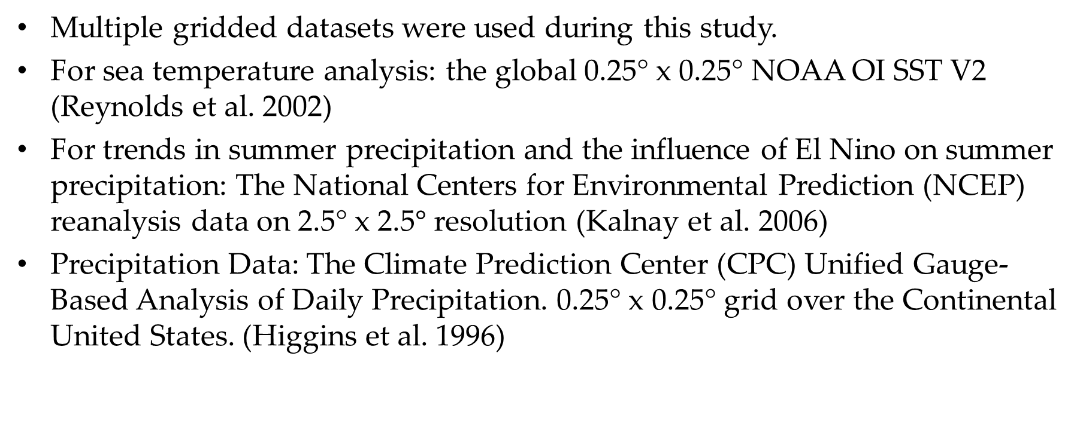
Data and Methodology
Multiple gridded datasets were used during this study.
For sea temperature analysis: the global 0.25° x 0.25° NOAA OI SST V2 (Reynolds et al. 2002)
For trends in summer precipitation and the influence of El Nino on summer precipitation: The National Centers for Environmental Prediction (NCEP) reanalysis data on 2.5° x 2.5$°$ resolution (Kalnay et al. 2006)
Precipitation Data: The Climate Prediction Center (CPC) Unified Gauge-Based Analysis of Daily Precipitation. 0.25° x 0.25° grid over the Continental United States. (Higgins et al. 1996)

Slide 5
What is the North American Monsoon (NAM)?
The NAM is associated with a shift in the winds from winter westerlies to summer southerly winds.
The mid-level anticyclonic flow (high pressure) moves north from its winter position to transition the winds to southerly over the Desert Southwest.
During summer, occasional moisture surges from the south bring enhanced thunderstorm activity to the Southwest
Enlarged figures on next two slides

Slide 6
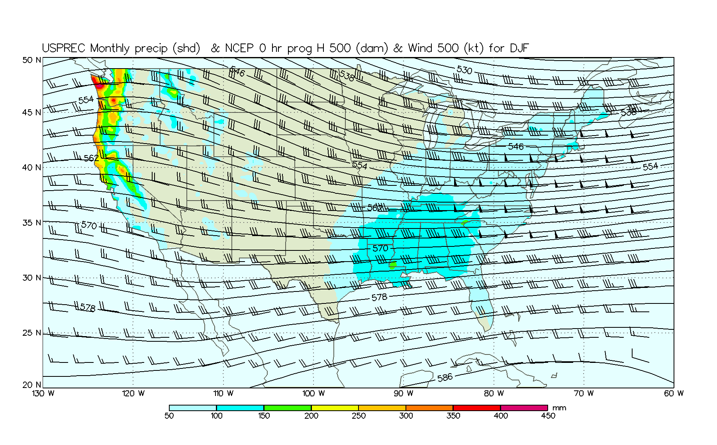

Slide 7
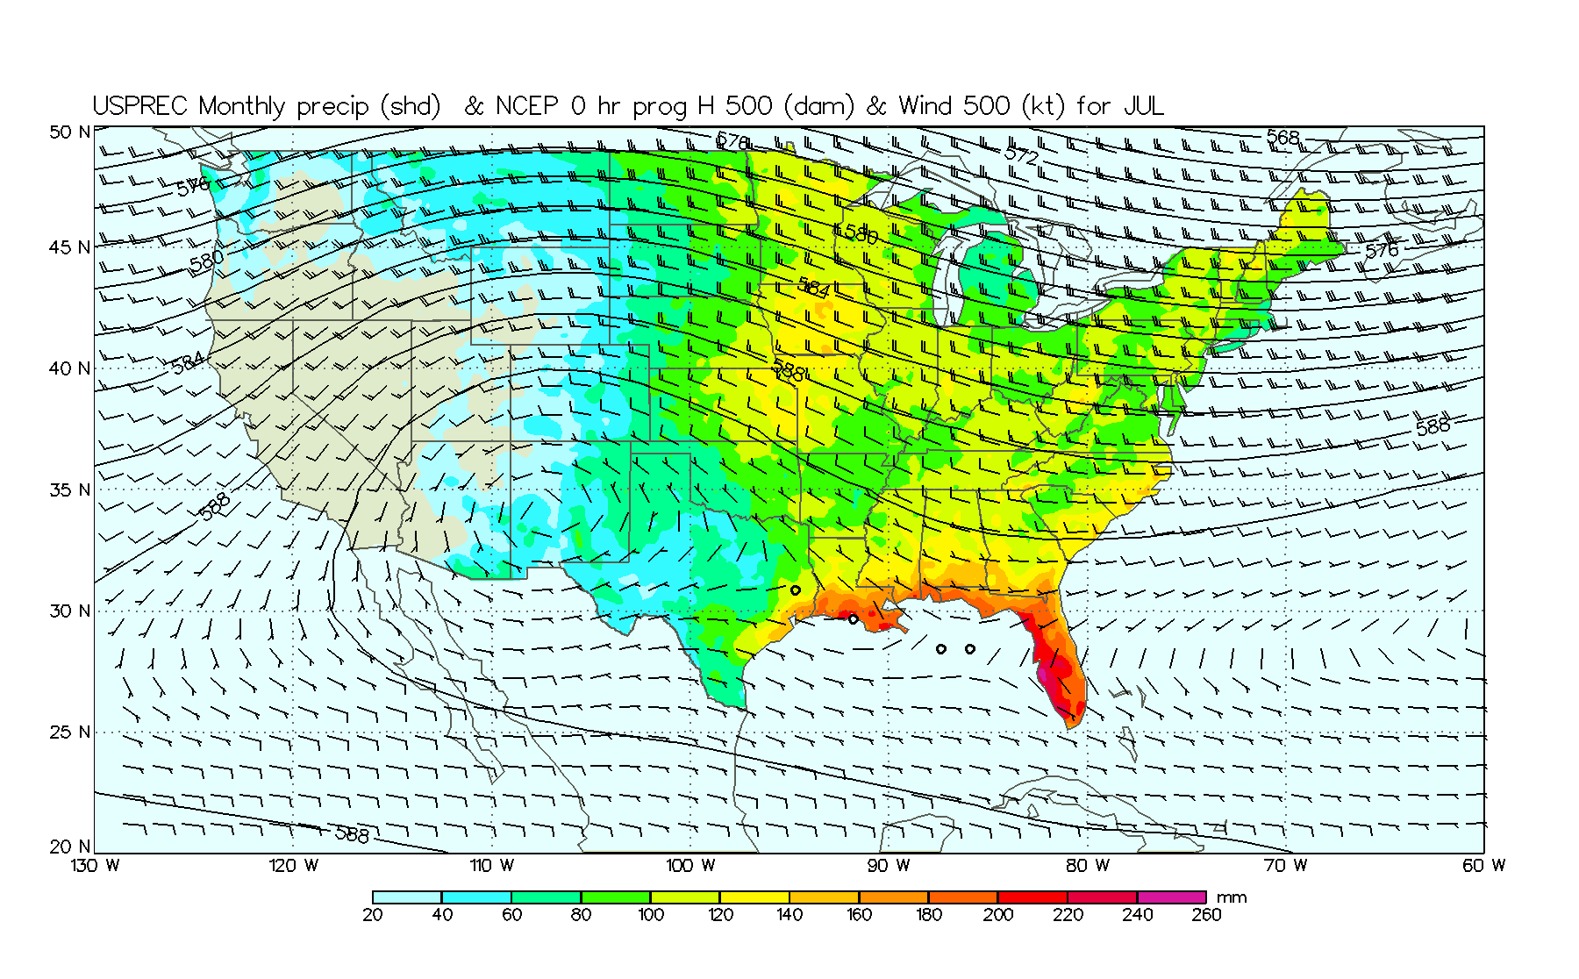

Slide 8
Understanding NAM Precipitation Variability
Previous studies of the NAM have attempted to understand causes of summer precipitation variability.
Sources of variability analyzed in this study:
  Sea surface temperatures (SST) in the Gulf of California (GOC)
  El Nino-Southern Oscillation
  Trends in summer precipitation

Slide 9
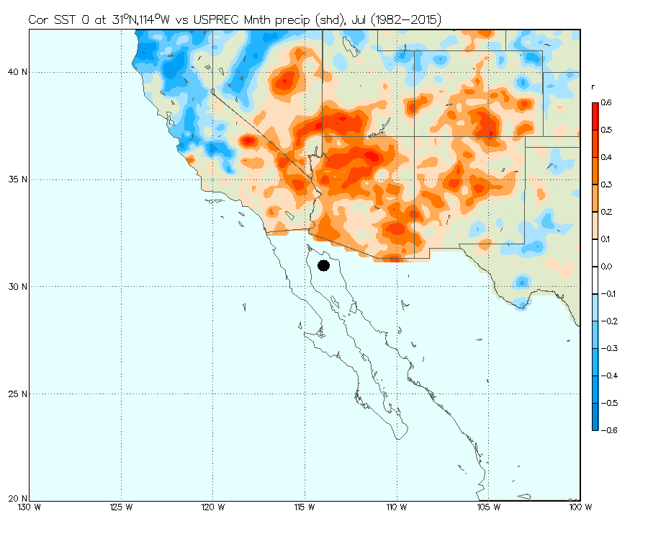
Sea Surface Temperatures (SST)
Strong correlation exists between SST in the northern GOC with precipitation at the start of the NAM (July).
  This is because warm air holds more moisture, which then moves north
GOC SST of ~31°C causes roughly 3.4 times the rainfall for SST of ~26°C. (Mitchell et al. 2002)
Thus, slight differences in SST have significant impacts on summer precipitation
Red (blue) means positive (negative) correlation between precipitation and SST

Slide 10
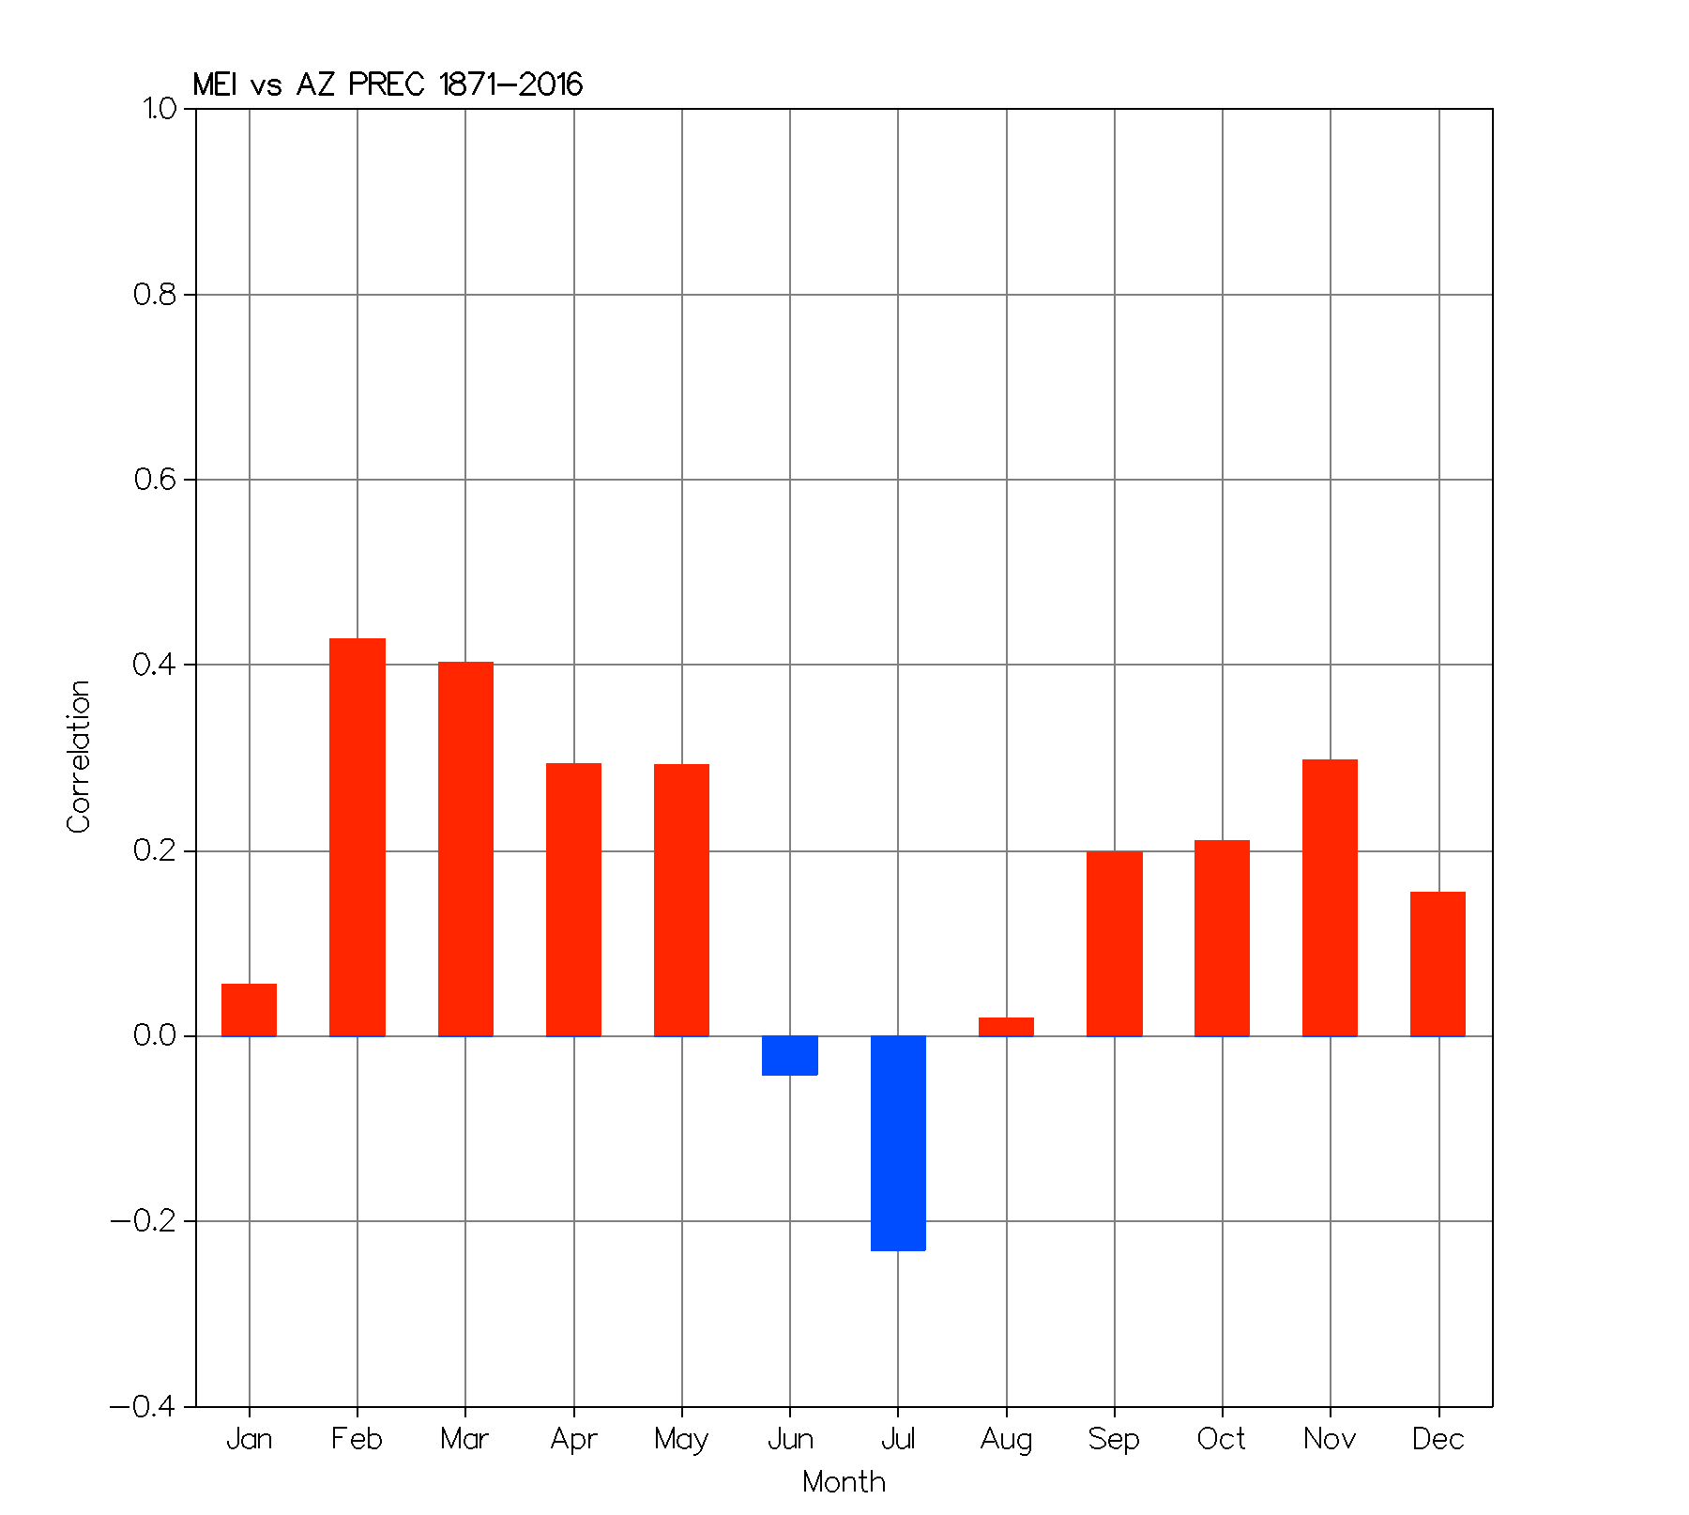

El Nino Southern Oscillation (ENSO) & the NAM
The connection between ENSO and the NAM is not well established.
The Multivariate ENSO Index (MEI) is used to define ENSO
    Positive means El Nino, negative La Nina
For most of the time, El Nino results in a wetter conditions
However in July, El Nino is associated with decreased precipitation, which may delay the onset of rainfall
Correlation between the MEI and Arizona precipitation
Red (blue) means positive (negative) correlation between the MEI and AZ precipitation
  La Nina favors a wet and early arrival to the NAM in July.

Slide 11
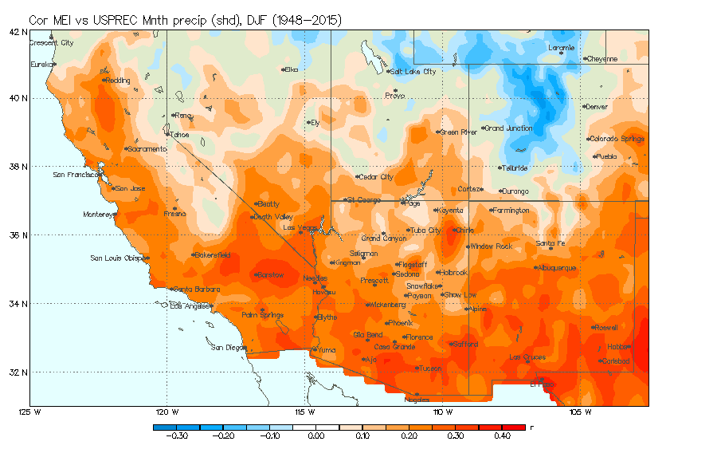
ENSO and Winter Precipitation
ENSO is strongly correlated with winter precipitation during the winter months.
El Nino (La Nina) favors enhanced (reduced) precipitation over the Southwest during winter.
Red means enhanced precip for El Nino, reduced for La Nina

Slide 12
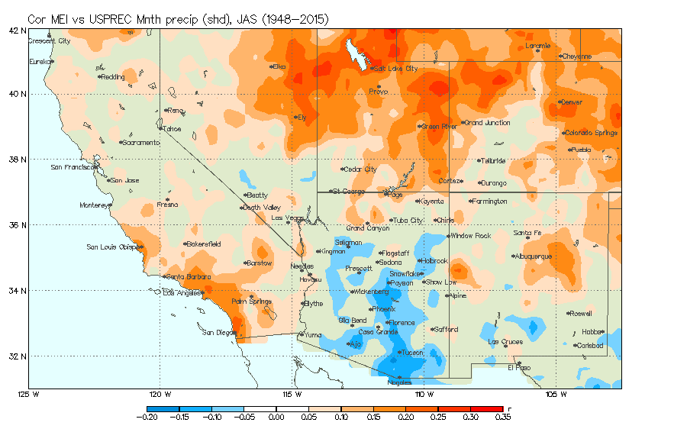
ENSO and Summer Precipitation
The correlation between the MEI and summer precipitation is negative (blue) over south/central Arizona.
During El Nino (La Nina) much of Arizona receives less (more) precipitation than normal.

Slide 13
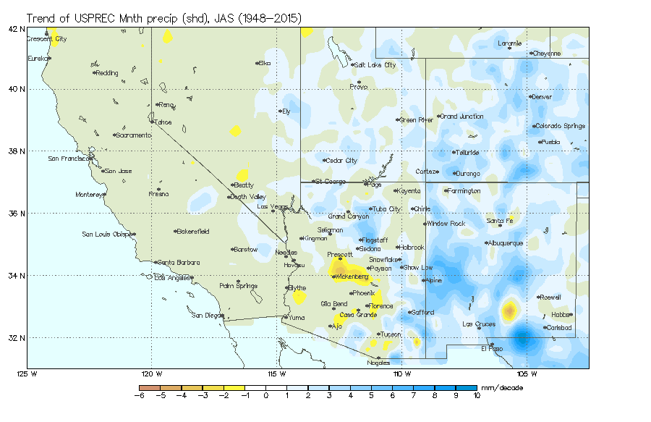
Trends in summer precipitation
The precipitation trend for July-Sept indicates wetter conditions across New Mexico and Northern Arizona.
Central Arizona is experiencing a drying trend

Slide 14
Summary and Conclusions
This study has examined the factors affecting the variability of precipitation over the Southwest
Small SST increases over the GOC can cause significant upturns in precipitation over the Southwest.
In July, El Nino (La Nina) favors decreased (increased) precipitation
Perhaps the most significant outcome of the study is the relationship between the arrival and onset of the NAM in July with ENSO. During an El Nino season that has persisted through winter, the NAM will be delayed into later July.

Slide 15
Acknowledgments
A heartfelt thank you belongs to my mentor, Dr. Mark Sinclair, for his passion on this study and for his experience in research and writing a cohesive thesis. I have grown as a technical writer and researcher thanks to his expertise. It is such expertise that enabled me to create the figures in this presentation based on his program, Meteorological Analysis & Diagnosis Software (MADS).
Thank you to the NASA Space Grant Consortium for the opportunity to expand this research and present today on my findings.

Slide 16
Questions
Thank you!

Slide 17
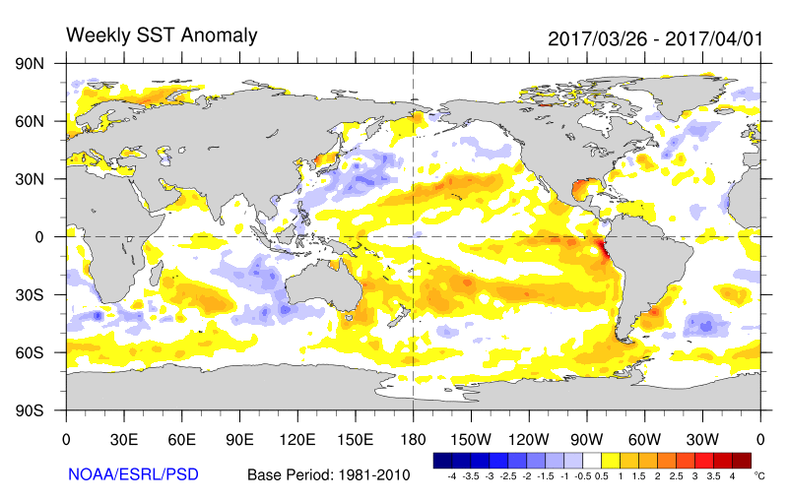
Forecast for this summer
The NOAA Climate Prediction Center is forecasting El Nino conditions starting early summer

